Slide 1

Orientation to Computing-I
L T P :2 0 0
1
www.lpu.in Lovely Professional University

Slide 2

UNIT - 3 Linux OS and its features
Linux is one of the popular versions of the UNIX operating System.
It is open source as its source code is freely available.
It is free to use.
Linux was designed considering UNIX compatibility.
Its functionality list is quite similar to that of UNIX.
2
www.lpu.in Lovely Professional University
Notes:
https://www.tutorialspoint.com/operating_system/os_linux.htm
2

Slide 3
Linux OS and its features
Components of Linux System
Linux Operating System has primarily three components
Kernel − Kernel is the core part of Linux. It is responsible for all major activities of this operating system. It consists of various modules and it interacts directly with the underlying hardware. Kernel provides the required abstraction to hide low level hardware details to system or application programs.
System Library − System libraries are special functions or programs using which application programs or system utilities accesses Kernel's features. These libraries implement most of the functionalities of the operating system and do not requires kernel module's code access rights.
System Utility − System Utility programs are responsible to do specialized, individual level tasks.
3
www.lpu.in Lovely Professional University
Notes:
https://www.tutorialspoint.com/operating_system/os_linux.htm
3

Slide 4
Kernel Mode vs User Mode
Kernel component code executes in a special privileged mode called kernel mode with full access to all resources of the computer. This code represents a single process, executes in single address space and do not require any context switch and hence is very efficient and fast. Kernel runs each processes and provides system services to processes, provides protected access to hardware to processes.
Support code which is not required to run in kernel mode is in System Library. User programs and other system programs works in User Mode which has no access to system hardware and kernel code. User programs/ utilities use System libraries to access Kernel functions to get system's low level tasks.
4
www.lpu.in Lovely Professional University

Slide 5
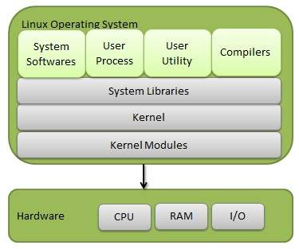
5
www.lpu.in Lovely Professional University

Slide 6
Basic Features
Portable − Portability means software can works on different types of hardware in same way. Linux kernel and application programs supports their installation on any kind of hardware platform.
Open Source − Linux source code is freely available and it is community based development project. Multiple teams work in collaboration to enhance the capability of Linux operating system and it is continuously evolving.
Multi-User − Linux is a multiuser system means multiple users can access system resources like memory/ ram/ application programs at same time.
Multiprogramming − Linux is a multiprogramming system means multiple applications can run at same time.
Hierarchical File System − Linux provides a standard file structure in which system files/ user files are arranged.
Shell − Linux provides a special interpreter program which can be used to execute commands of the operating system. It can be used to do various types of operations, call application programs. etc.
Security − Linux provides user security using authentication features like password protection/ controlled access to specific files/ encryption of data.
6
www.lpu.in Lovely Professional University

Slide 7
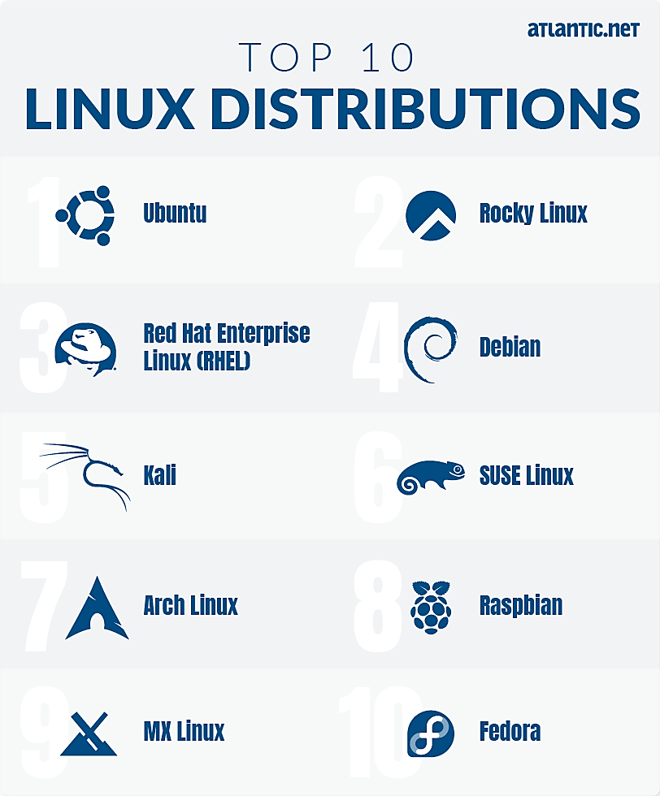
Distribution versions
7
www.lpu.in Lovely Professional University

Slide 8
Installation
Insert a bootable Linux USB drive
Click the start menu
Then hold down the SHIFT key while clicking Restart
Then select Use a Device
Find your device in the list
Your computer will now boot Linux
Select Install Linux
Go through the installation process
8
www.lpu.in Lovely Professional University
Notes:
Reference Links:
Centos:
https://vitux.com/install-centos-with-virtualbox-on-windows/
Ubuntu:
https://www.wikihow.com/Install-Ubuntu-on-VirtualBox
8

Slide 9
Linux Directory Structure and File System Hierarchy
Dir | Description
/ | The directory called "root." It is the starting point for the file system hierarchy. Note that this is not related to the root, or superuser, account.
/bin | Binaries and other executable programs.
/etc | System configuration files.
/home | Home directories.
/opt | Optional or third party software.
/tmp | Temporary space, typically cleared on reboot.
/usr | User related programs.
/var | Variable data, most notably log files.
9
www.lpu.in Lovely Professional University

Slide 10
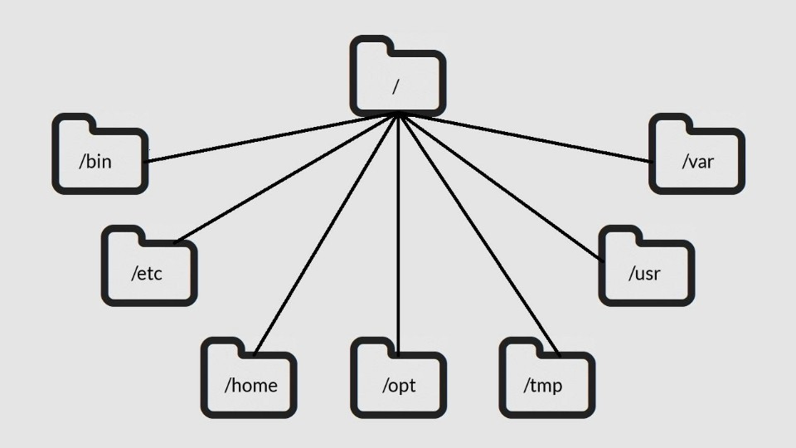
10
www.lpu.in Lovely Professional University
Notes:
https://www.linuxtrainingacademy.com/linux-directory-structure-and-file-system-hierarchy/
10

Slide 11
How to partition a disk in Linux
Creating and deleting partitions in Linux is a regular practice because storage devices (such as hard drives and USB drives) must be structured in some way before they can be used.
In most cases, large storage devices are divided into separate sections called partitions. Partitioning also allows you to divide your hard drive into isolated sections, where each section behaves as its own hard drive.
11
Notes:
https://opensource.com/article/18/6/how-partition-disk-linux
11

Slide 12
How to partition a disk in Linux
The following explains the process of partitioning a storage device with the parted command.
List the partitions: Use parted -l to identify the storage device you want to partition.
Typically, the first hard disk (/dev/sda or /dev/vda) will contain the operating system, so look for another disk to find the one you want (e.g., /dev/sdb, /dev/sdc, /dev/vdb, /dev/vdc, etc.).
12
www.lpu.in Lovely Professional University
Notes:
https://opensource.com/article/18/6/how-partition-disk-linux
12

Slide 13
2. Open the storage device: Use parted to begin working with the selected storage device. It is important to indicate the specific device you want to use. If you just type parted with no device name, it will randomly select a storage device to modify.
3. Set the partition table: Set the partition table type to GPT, then type "Yes" to accept it. The mklabel and mktable commands are used for the same purpose (making a partition table on a storage device). The supported partition tables are: aix, amiga, bsd, dvh, gpt, mac, ms-dos, pc98, sun, and loop. Remember mklabel will not make a partition, rather it will make a partition table.
13
www.lpu.in Lovely Professional University

Slide 14
4. Review the partition table: Show information about the storage device.
5. Get help: To find out how to make a new partition, type: (parted) help mkpart.
6. Make a partition: To make a new partition (in this example, 1,396MB on partition 0), type the following:
(parted) mkpart primary 0 1396MB
14
www.lpu.in Lovely Professional University

Slide 15
Comparison of Windows and Linux OS
S.NO | Linux | Windows
1. | Linux is a open source operating system. | While windows are the not the open source operating system.
2. | Linux is free of cost. | While it is costly.
3. | It’s file name case-sensitive. | While it’s file name is case-insensitive.
4. | In Linux, monolithic kernel is used. | While in this, micro kernel is used.
5. | Linux is more efficient in comparison of windows. | While windows are less efficient.
6. | There is forward slash is used for Separating the directories. | While there is back slash is used for Separating the directories.
7. | Linux provides more security than windows. | While it provides less security than Linux.
8. | Linux is widely used in hacking purpose based systems. | While windows does not provide much efficiency in hacking.
9. | There are 3 types of user account – (1) Regular , (2) Root , (3) Service account | There are 4 types of user account – (1) Administrator , (2) Standard , (3) Child , (4) Guest
10. | Root user is the super user and has all administrative privileges. | Administrator user has all administrative privileges of computers.
11. | Linux file naming convention in case sensitive. Thus, sample and SAMPLE are 2 different files in Linux/Unix operating system. | In Windows, you cannot have 2 files with the same name in the same folder.
15
www.lpu.in Lovely Professional University
Notes:
https://www.geeksforgeeks.org/difference-between-linux-and-windows/
15

Slide 16
Virtual Machines
A Virtual Machine (VM) is a compute resource that uses software instead of a physical computer to run programs and deploy apps. One or more virtual “guest” machines run on a physical “host” machine. Each virtual machine runs its own operating system and functions separately from the other VMs, even when they are all running on the same host. This means that, for example, a virtual MacOS virtual machine can run on a physical PC.
Virtual machine technology is used for many use cases across on-premises and cloud environments. More recently, public cloud services are using virtual machines to provide virtual application resources to multiple users at once, for even more cost efficient and flexible compute.
16
www.lpu.in Lovely Professional University
Notes:
https://www.vmware.com/topics/glossary/content/virtual-machine.html#:~:text=A%20Virtual%20Machine%20(VM)%20is,a%20physical%20%E2%80%9Chost%E2%80%9D%20machine.
16

Slide 17
What are virtual machines used for?
Virtual machines (VMs) allow a business to run an operating system that behaves like a completely separate computer in an app window on a desktop.
VMs may be deployed to accommodate different levels of processing power needs, to run software that requires a different operating system, or to test applications in a safe, sandboxed environment.
Virtual machines have historically been used for server virtualization, which enables IT teams to consolidate their computing resources and improve efficiency.
17
www.lpu.in Lovely Professional University

Slide 18
What are virtual machines used for?
Additionally, virtual machines can perform specific tasks considered too risky to carry out in a host environment, such as accessing virus-infected data or testing operating systems. Since the virtual machine is separated from the rest of the system, the software inside the virtual machine cannot tamper with the host computer.
How do virtual machines work?
The virtual machine runs as a process in an application window, similar to any other application, on the operating system of the physical machine. Key files that make up a virtual machine include a log file, NVRAM setting file, virtual disk file and configuration file.
18
www.lpu.in Lovely Professional University

Slide 19
Other Shell Commands:
ls
cat
man
cd
touch
cp
mv
rmdir
mkdir
rm
chmod
pwd
ps
kill
19

Slide 20
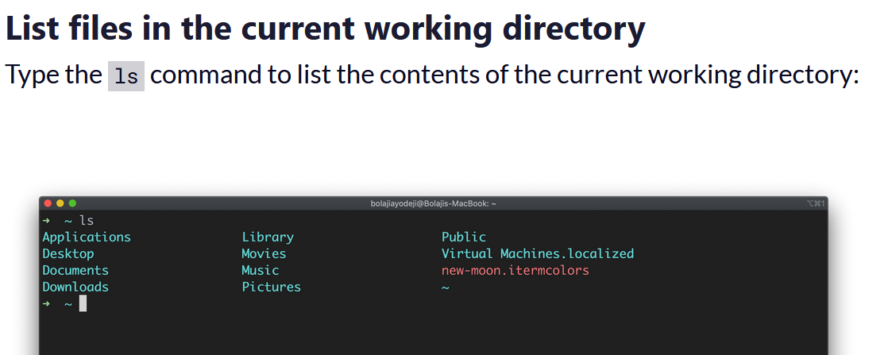
ls command
The ls command is used to list files or directories in Linux and other Unix-based operating systems.
Use of ls command as below:
20
www.lpu.in Lovely Professional University

Slide 21
cat command
Outputs the contents of a text file.
You can use it to read brief files or to concatenate files together.
To append file1 onto the end of file2, enter:
cat file1 >> file2
To view the contents of a file named myfile, enter:
cat myfile
21
www.lpu.in Lovely Professional University

Slide 22
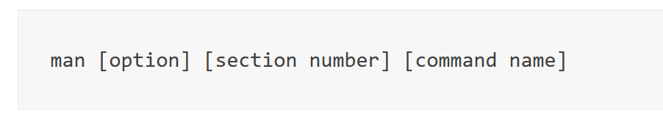
man command
The man command is a built-in manual for using Linux commands.
Displays the user manual of any command that we can run on the terminal. It provides a detailed view of the command which includes NAME, SYNOPSIS, DESCRIPTION, OPTIONS, EXIT STATUS, RETURN VALUES, ERRORS, FILES, VERSIONS, EXAMPLES, AUTHORS.
Basic Symbol
option – the search result output.
section number – the section in which to look for the man page.
command name – the name of the command which man page you want to see.
22
www.lpu.in Lovely Professional University

Slide 23
cd command
It changes your current directory location.
By default, your Unix login session begins in your home directory.
To switch to a subdirectory (of the current directory) named myfiles, enter:
cd myfiles
To switch to a directory named /home/dvader/empire_docs, enter:
cd /home/dvader/empire_docs
23
www.lpu.in Lovely Professional University

Slide 24
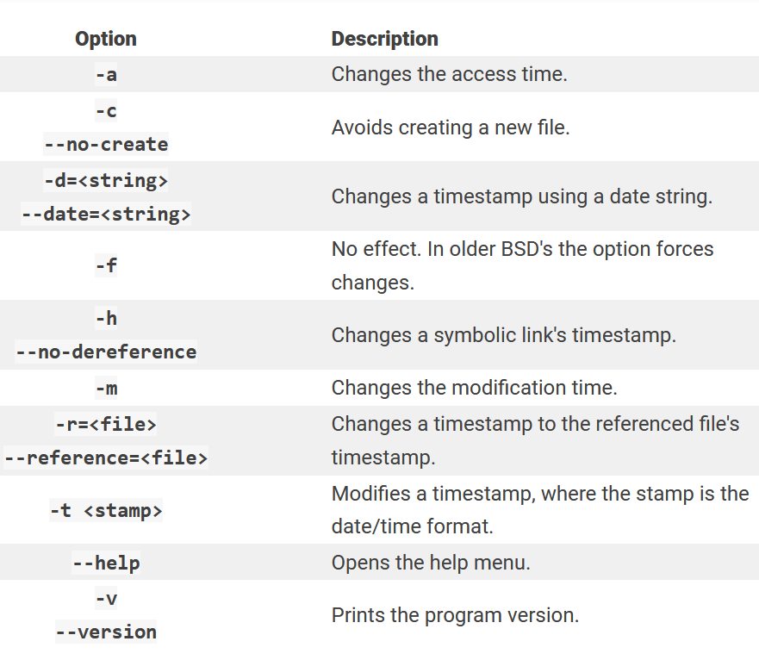
Touch
The touch command's primary function is to modify a timestamp.
24

Slide 25
cp
This command copies a file, preserving the original and creating an identical copy.
cp -i oldfile newfile
mv
mv stands for move.
mv is used to move one or more files or directories from one place to another in a file system like UNIX.
Use it as:
mv [Option] source destination
chmod
This command changes the permission information associated with a file.
25
www.lpu.in Lovely Professional University

Slide 26
Mkdir
The mkdir command is used to create (or make) a directory.
Example:
# mkdir LPUCSE
rmdir
The rmdir directory is used to remove directories, but only those that are empty (i.e., contain no files or subdirectories). In order to delete a directory with actual contents, you must use the rm -R command.
Example
To remove an empty directory:
# rmdir /mike
26
www.lpu.in Lovely Professional University

Slide 27
Rm
Use the rm command to remove files you no longer need.
Example
Removing one file at a time
$ rm CSEA.txt
Pwd
Simply type pwd into your terminal, and the command will output the absolute path of your print working directory.
The pwd command writes to standard output the full path name of your current directory (from the root directory). All directories are separated by a / (slash). The root directory is represented by the first /, and the last directory named is your current directory.
The ps command, short for Process Status, is a command line utility that is used to display or view information related to the processes running in a Linux system.
27
www.lpu.in Lovely Professional University

Slide 28
ps
The ps command, short for Process Status, is a command line utility that is used to display or view information related to the processes running in a Linux system.
kill
kill command in Linux (located in /bin/kill), is a built-in command which is used to terminate processes manually.
28
www.lpu.in Lovely Professional University

Slide 29
Activity
Execute various commands on Linux Operating System
29
www.lpu.in Lovely Professional University

Slide 30
Kernel and types of kernels
A Kernel is an intermediary between applications and hardware.
Functions of a Kernel
A Kernel in an operating system performs the following functions:
Device Management: Processes require various peripheral devices such as a mouse and keyboard connected to the computer to perform various tasks. The Kernel manages the allocation of the peripheral devices.
Resource Management: Kernel shares the resources between different processes while ensuring that every process has uniform access to the resources.
Memory Management: Every process requires some memory to execute. The Kernel allows the processes to access the memory safely.
Access Computer Resource: A kernel can access different computer resources such as RAM, CPU, I/O devices, and other resources. The Kernel decides which memory each process will use, and the action is taken if memory is unavailable.
30
www.lpu.in Lovely Professional University

Slide 31
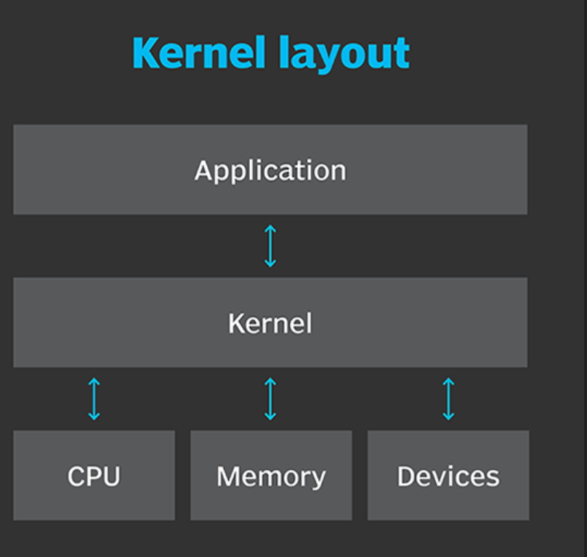
More about Linux Kernel
31
www.lpu.in Lovely Professional University

Slide 32
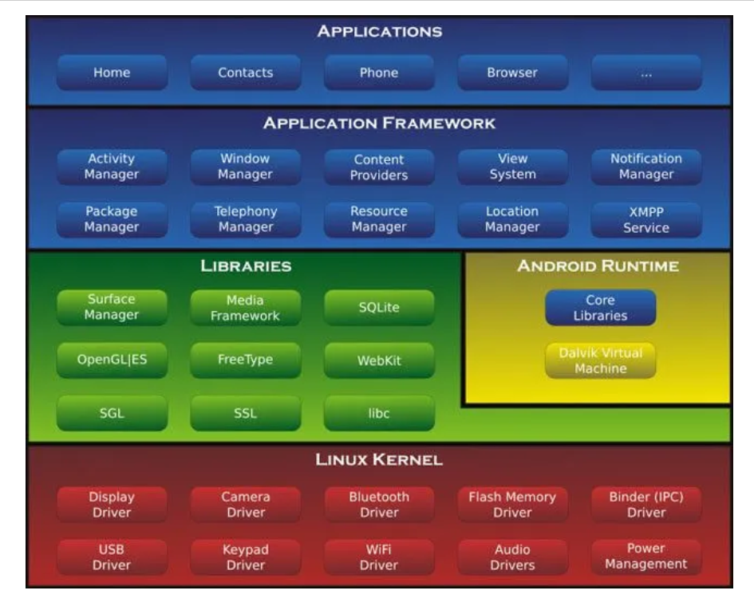
More about Linux Kernel
32
www.lpu.in Lovely Professional University

Slide 33
Basic types of kernels
3 basic types of kernels as below:
Monolithic
Microkernel
Hybrid
A monolithic kernel is a type of kernel in which the complete OS runs in the kernel space.
A microkernel is a kernel type that implements an operating system by providing methods, including low-level address space management, IPC, and thread management.
A hybrid kernel is an operating system kernel architecture that attempts to combine aspects and benefits of microkernel and monolithic kernel architectures used in computer operating systems.
33
www.lpu.in Lovely Professional University

Slide 34
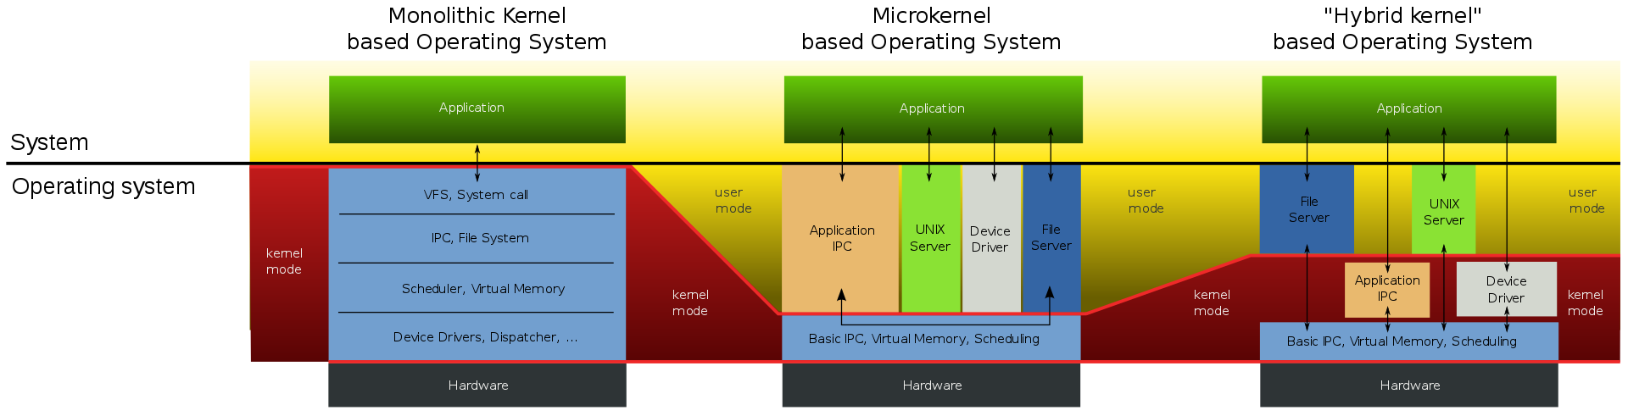
Basic types of kernels
34
www.lpu.in Lovely Professional University
Notes:
https://en.wikipedia.org/wiki/Monolithic_kernel#/media/File:OS-structure2.svg
34

